Slide 1
Web components
“A set of standards currently being produced … as a W3C specification that allow for the creation of reusable widgets or components in web documents and web applications. The intention behind them is to bring component-based software engineering to the World Wide Web. The components model allows for encapsulation and interoperability of individual HTML elements”
Wikipedia

Slide 2
Index
Templates (inert chunks of cloneable DOM)
<template id="mytemplate">
<img src=“/path/to/webcomponents.jpg” alt=“webcomponents”/>
…more html elements…
</template>
HTML imports
<link rel="import" href="/path/to/imports/stuff.html">
Custom elements
<supper-button>Some text</supper-button>
Shadow DOM (DOM tree encapsulation)
<video src=“http://path//to//video.mp4”>
#shadow-root
<div>
...a lot of nested and complex html elements…
</div>
</video>

Slide 3
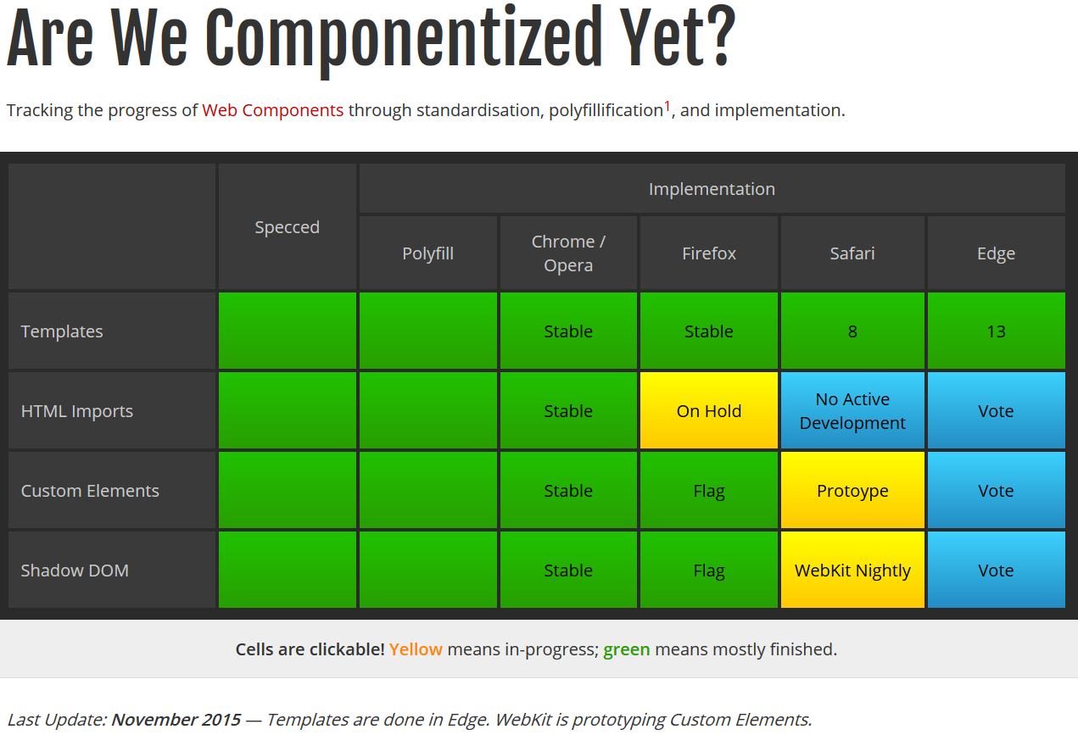
State of the art

Slide 4
State of the art
Microsoft “User Voice” most voted features are the 3 remaining web components standards.
Mozilla thinks HTML Imports is not needed when ES6 modules come out
Webcomponents.org provides up to date polyfills for the web components standards.
X-Tags (Microsoft) , Polymer (Google) and Bosonic are three of the main libraries on top of the web components standard.

Slide 5
Templates
The template element is used to declare inert fragments of HTML that can be cloned and inserted in the document by script. This process is called activation.
In a rendering, the template element represents nothing.
Templates have one property : content.
If you nest templates, each template must be cloned and added manually
In other words:
Inert and inactive: Templates are parsed, but do nothing until cloned and added to the body. Scripts don’t run, images don’t load, audio and video does not play until the template is activated.
Flexible placement: You can put it anywhere in the html.
Content is considered not to be in the document, until activated. Selectors will not work unless you use the ‘content’ property of the template

Slide 6
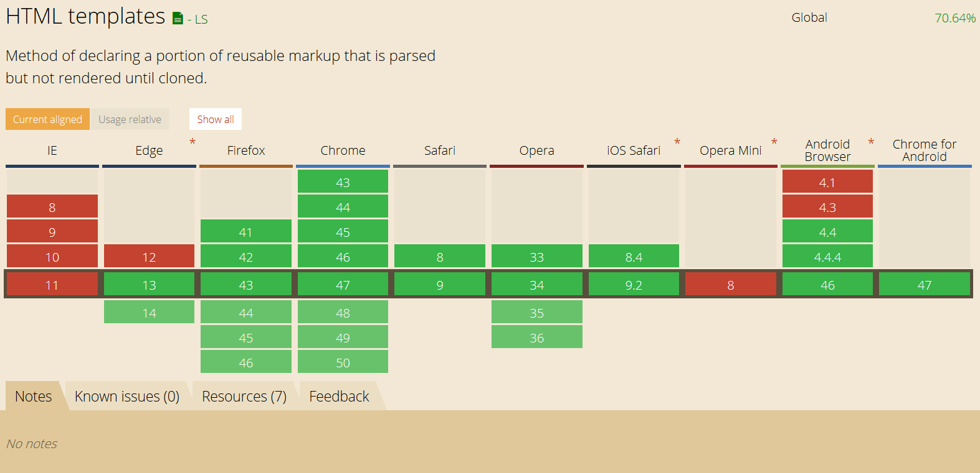
Templates

Slide 7
HTML Imports
How to include html in a webpage?<link rel=“import” href=“some.html”
The content of an import can be accessed in js:
var content = document.querySelector('link[rel="import"]').import;
Use cases:
Bundling resources:
new way to import boostrap <link rel="import" href="bootstrap.html">
Browser network stack, automatically de-dupes requests from the same URL, so it’s ok if included several times
Scripting in imports:
References the importer, i.e. the main document: document
References the importee, the imported document: document.currentScript.ownerDocument
Scripts in the import page are executed in the context of the main document.
Including templates into the main document
Delivering web components which could auto register themselves (obviously)
Imports block rendering. If imports take too much due to some scripts for example, you can observe delays on the main page.

Slide 8
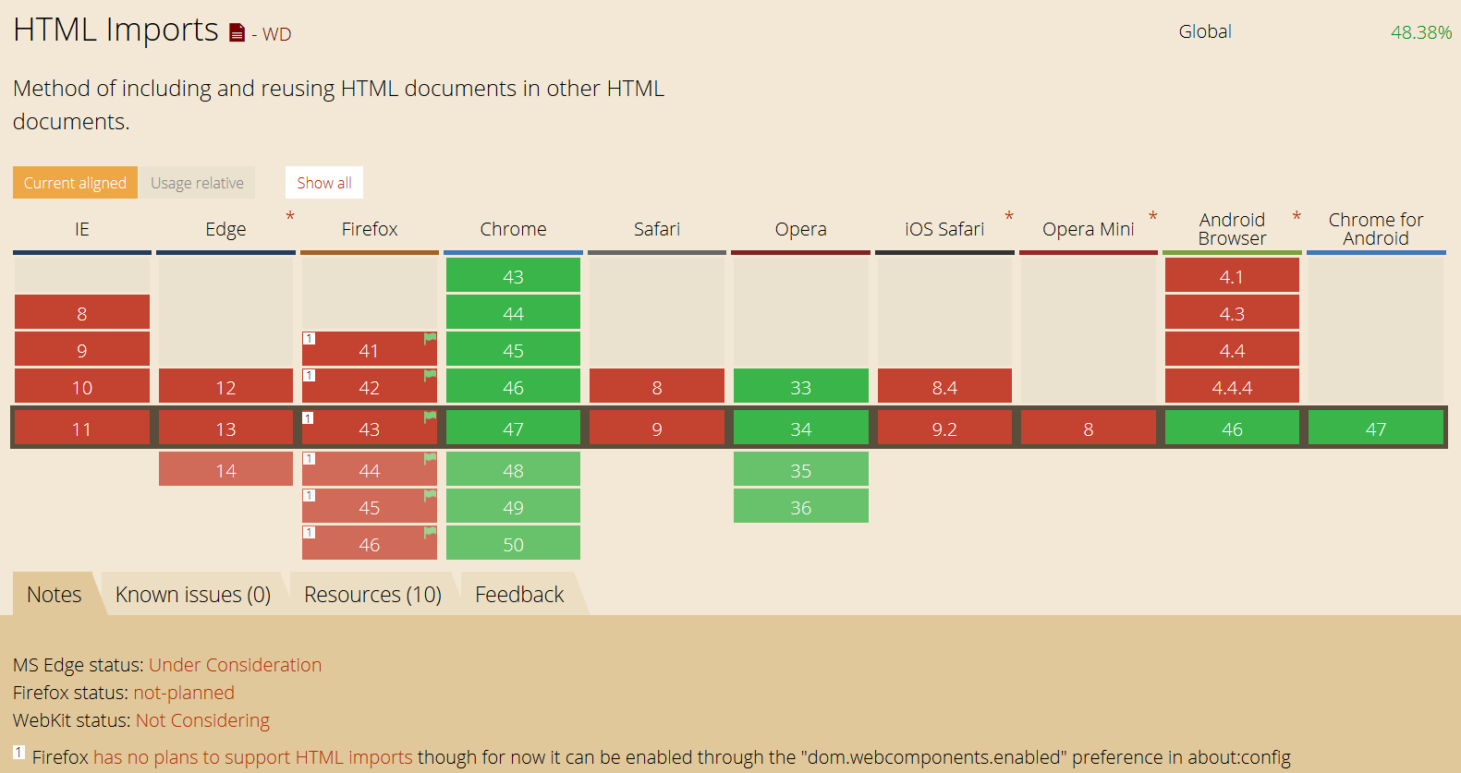
Html imports
*Does not work in Firefox, need polyfill and flag set to off

Slide 9
Custom Elements
Allow web developers to define new types of HTML elements, or extend existing ones.
Custom elements must have a dash (-) in their name
Elements with valid custom element names (e.g. “my-element”) inherit from HTMLElement
Elements with invalid custom element names (e.g. “randomElement”) inherit from HTMLUnknownElement
Unknown elements, or unresolved (unregistered) elements, are just ignored.
Valid custom elements can be registered later on, and show up on the page, unlike invalid custom element names.

Slide 10
Custom elements: creation
Create a prototype
var someProto= Object.create(HTMLElement.prototype);
Register the element
var someElCtr= document.registerElement(‘some-el-extended', { prototype: someProto, extends: ‘button' });
Instantiate it
Declare them:
Simple custom element: <some-button></some-button>
If they extend: <button is=“some-el-extended”></button>
Create in JS and then append it:
Create:
Using createElement: var myElement= document.createElement ('button', ' some-el-extended ');
Or using the constructor: var myElement= new someElCtr();
Append:
document.body.appendChild(myElement);

Slide 11
Custom elements: lifecicle & api
Any custom element can have 4 lifecycle methods on its prototype, which are called on certain events:
createdCallback – when an instance of the element is created
attachedCallback – when an instance was inserted into the document
detachedCallback – when an instance was removed from the document
attributeChangedCallback(attrName, oldVal, newVal) – when an atribute was added, removed or updated
If you want to attach some method to the custom element just add it to the prototype.

Slide 12
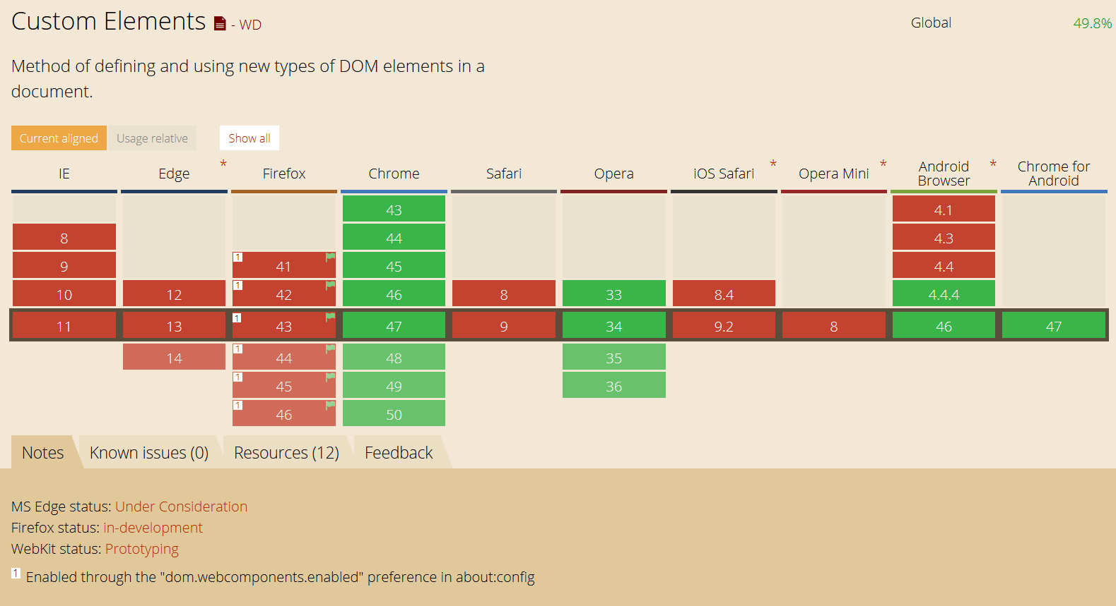
Custom elements

Slide 13
Shadow DOM
The DOM tree inside a widget is encapsulated from the rest of the page.
Already in use today, e.g. <video>
There are specific ways to cross through the shadow DOM
Shadow DOM has the same methods as the normal DOM (just use shadow root instead of document)
Shadow host is any html element, host of the shadow root, therefore containing the shadow DOM

Slide 14
Shadow DOM
The content of the shadow root is rendered in the place of the content of the shadow host.
Even if querying the shadow root content in JS, shows the static content, the content of the shadow host.
Use <content select=“someCssSelector”> to display content from the shadow host (immediate children only) into the shadow root.
<content> does not move the node to the display point, just renders it there.
<shadow> is the same as <content> except it displays whole shadow trees!
What this means is: separation between content and presentation.

Slide 15
Shadow DOM: styling
:host(<selector>) allows you to style the host element if it matches a <selector>
:host-context(<selector>) pseudo class matches the host element if it or any of its ancestors matches <selector>
Css ::shadow, /deep/ (aka '>>>') allows to pierce through Shadow DOM boundary, but have been deprecated
To style distributed nodes use ::content
JS piercing:
document.querySelector('x-tabs').shadowRoot .querySelector('x-panel') or
document.querySelector('x-tabs::shadow x-panel');

Slide 16
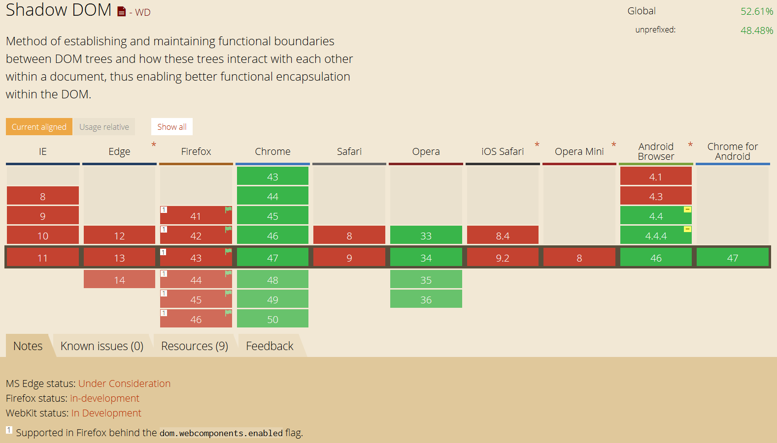
Shadow DOM

Slide 17
Resources
State of the art
http://jonrimmer.github.io/are-we-componentized-yet/
https://blogs.windows.com/msedgedev/2015/07/14/bringing-componentization-to-the-web-an-overview-of-web-components
http://x-tag.github.io/
https://www.polymer-project.org/1.0/
http://webcomponents.org/
https://customelements.io/
https://hacks.mozilla.org/2014/12/mozilla-and-web-components/
Custom elements
http://www.html5rocks.com/en/tutorials/webcomponents/customelements/
HTML Imports
http://www.html5rocks.com/en/tutorials/webcomponents/imports/
Templates
www.html5rocks.com/en/tutorials/webcomponents/template
https://html.spec.whatwg.org/multipage/scripting.html#the-template-element
http://webcomponents.org/articles/introduction-to-template-element/
Shadow DOM
http://www.html5rocks.com/en/tutorials/webcomponents/shadowdom/
http://www.html5rocks.com/en/tutorials/webcomponents/shadowdom-201/
http://www.html5rocks.com/en/tutorials/webcomponents/shadowdom-301/
http://caniuse.com/

